Slide 1
Common Sense and The Declaration of Independence
Chapter 3 Section 2

Slide 2
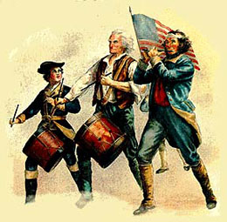
Pick a Side!
Loyalists
Patriots
Colonists who were loyal to England
Also known as ‘Tories’
Felt like the colonies did not need independence
More than 50,000 Loyalists fled the colonies during the Revolutionary War
Ben Franklin had a Loyalist son!
Colonists who wanted independence from England
Opposed the lack of representation in Parliament

Slide 3
Pick a Side!
Undecided
30%
Patriots
45%
Loyalists
25%

Slide 4
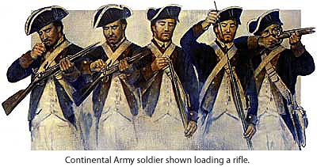
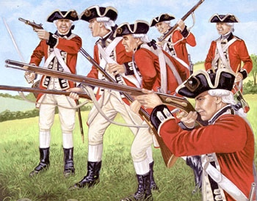
Continental Army
British Army
Nicknames: Minutemen, Patriots, Militia
Nicknames: Redcoats, Tories, Regulars
Strengths:
-Excellent leadership
-Extreme motivation to fight
-Fighting on home turf
Weaknesses:
-Limited supplies
-Limited naval support
-Limited experience
Strengths:
-Very experienced
-Very well trained and disciplined
-Extremely well supplied and funded
Weaknesses:
-Fighting far from home
-Old tactics
OVERALL:
UNDERDOGS
OVERALL:
CLEAR ADVANTAGE

Slide 5
Common Sense
“There is something very absurd in supposing a continent to be perpetually (forever) governed by an island”
500,000 copies were sold
Written in the “common” voice to appeal to all colonists
Changed the way colonists viewed their King

Slide 6
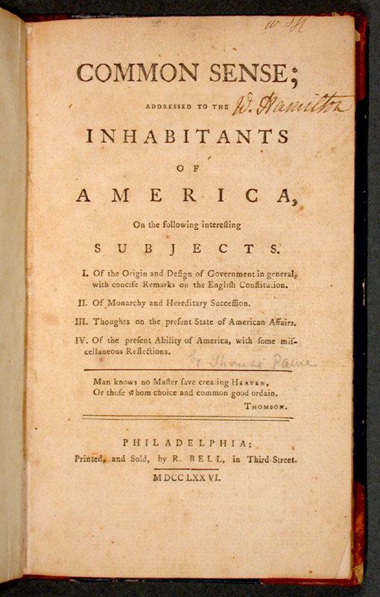
Common Sense
Definition- A 47 page pamphlet published in January 1776 that urged the separation from Great Britain. Caused the colonists to question the king’s authority.

Slide 7
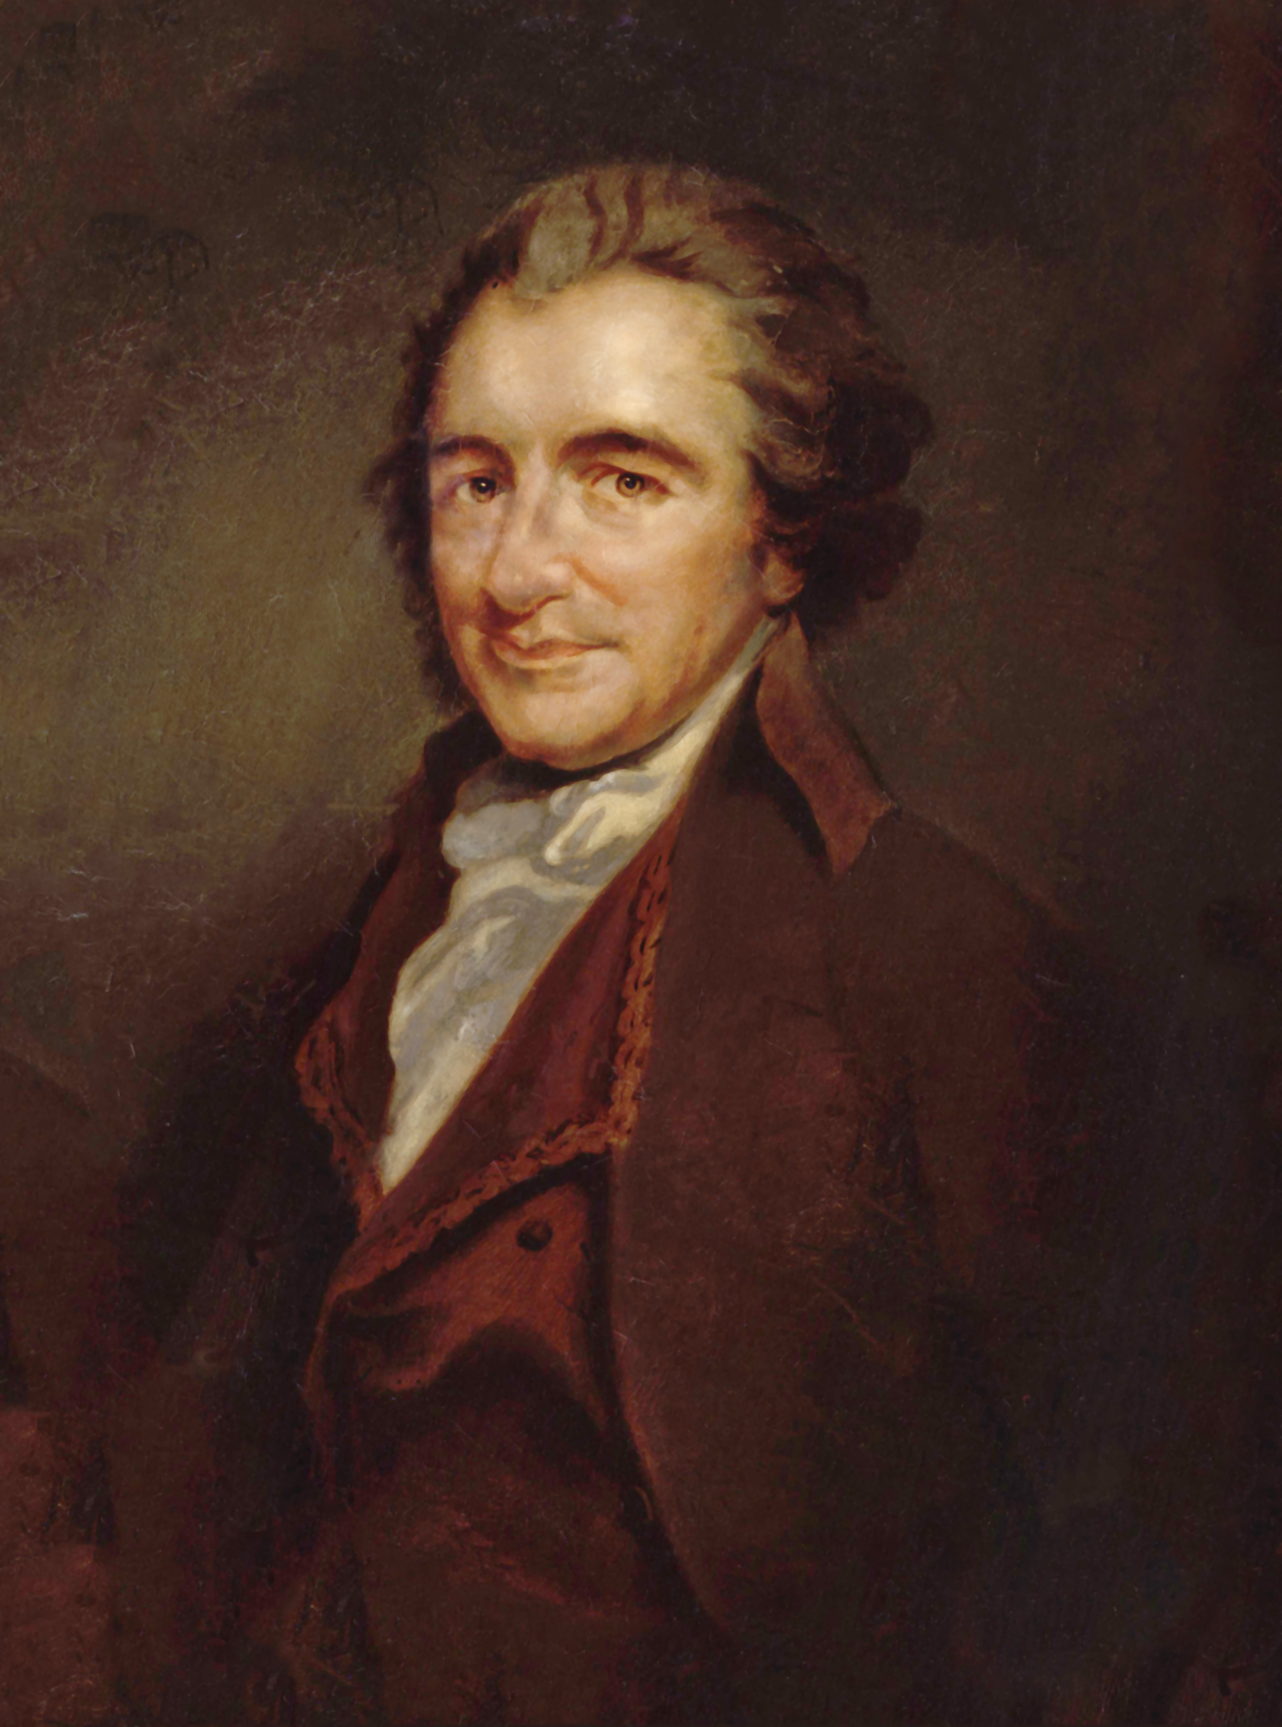
Common Sense
Author- Thomas Paine
But at first the pamphlets were released anonymously (without an author listed)

Slide 8
Common Sense
Idea #1- Argued that citizens (NOT Kings and Queens) should make laws

Slide 9
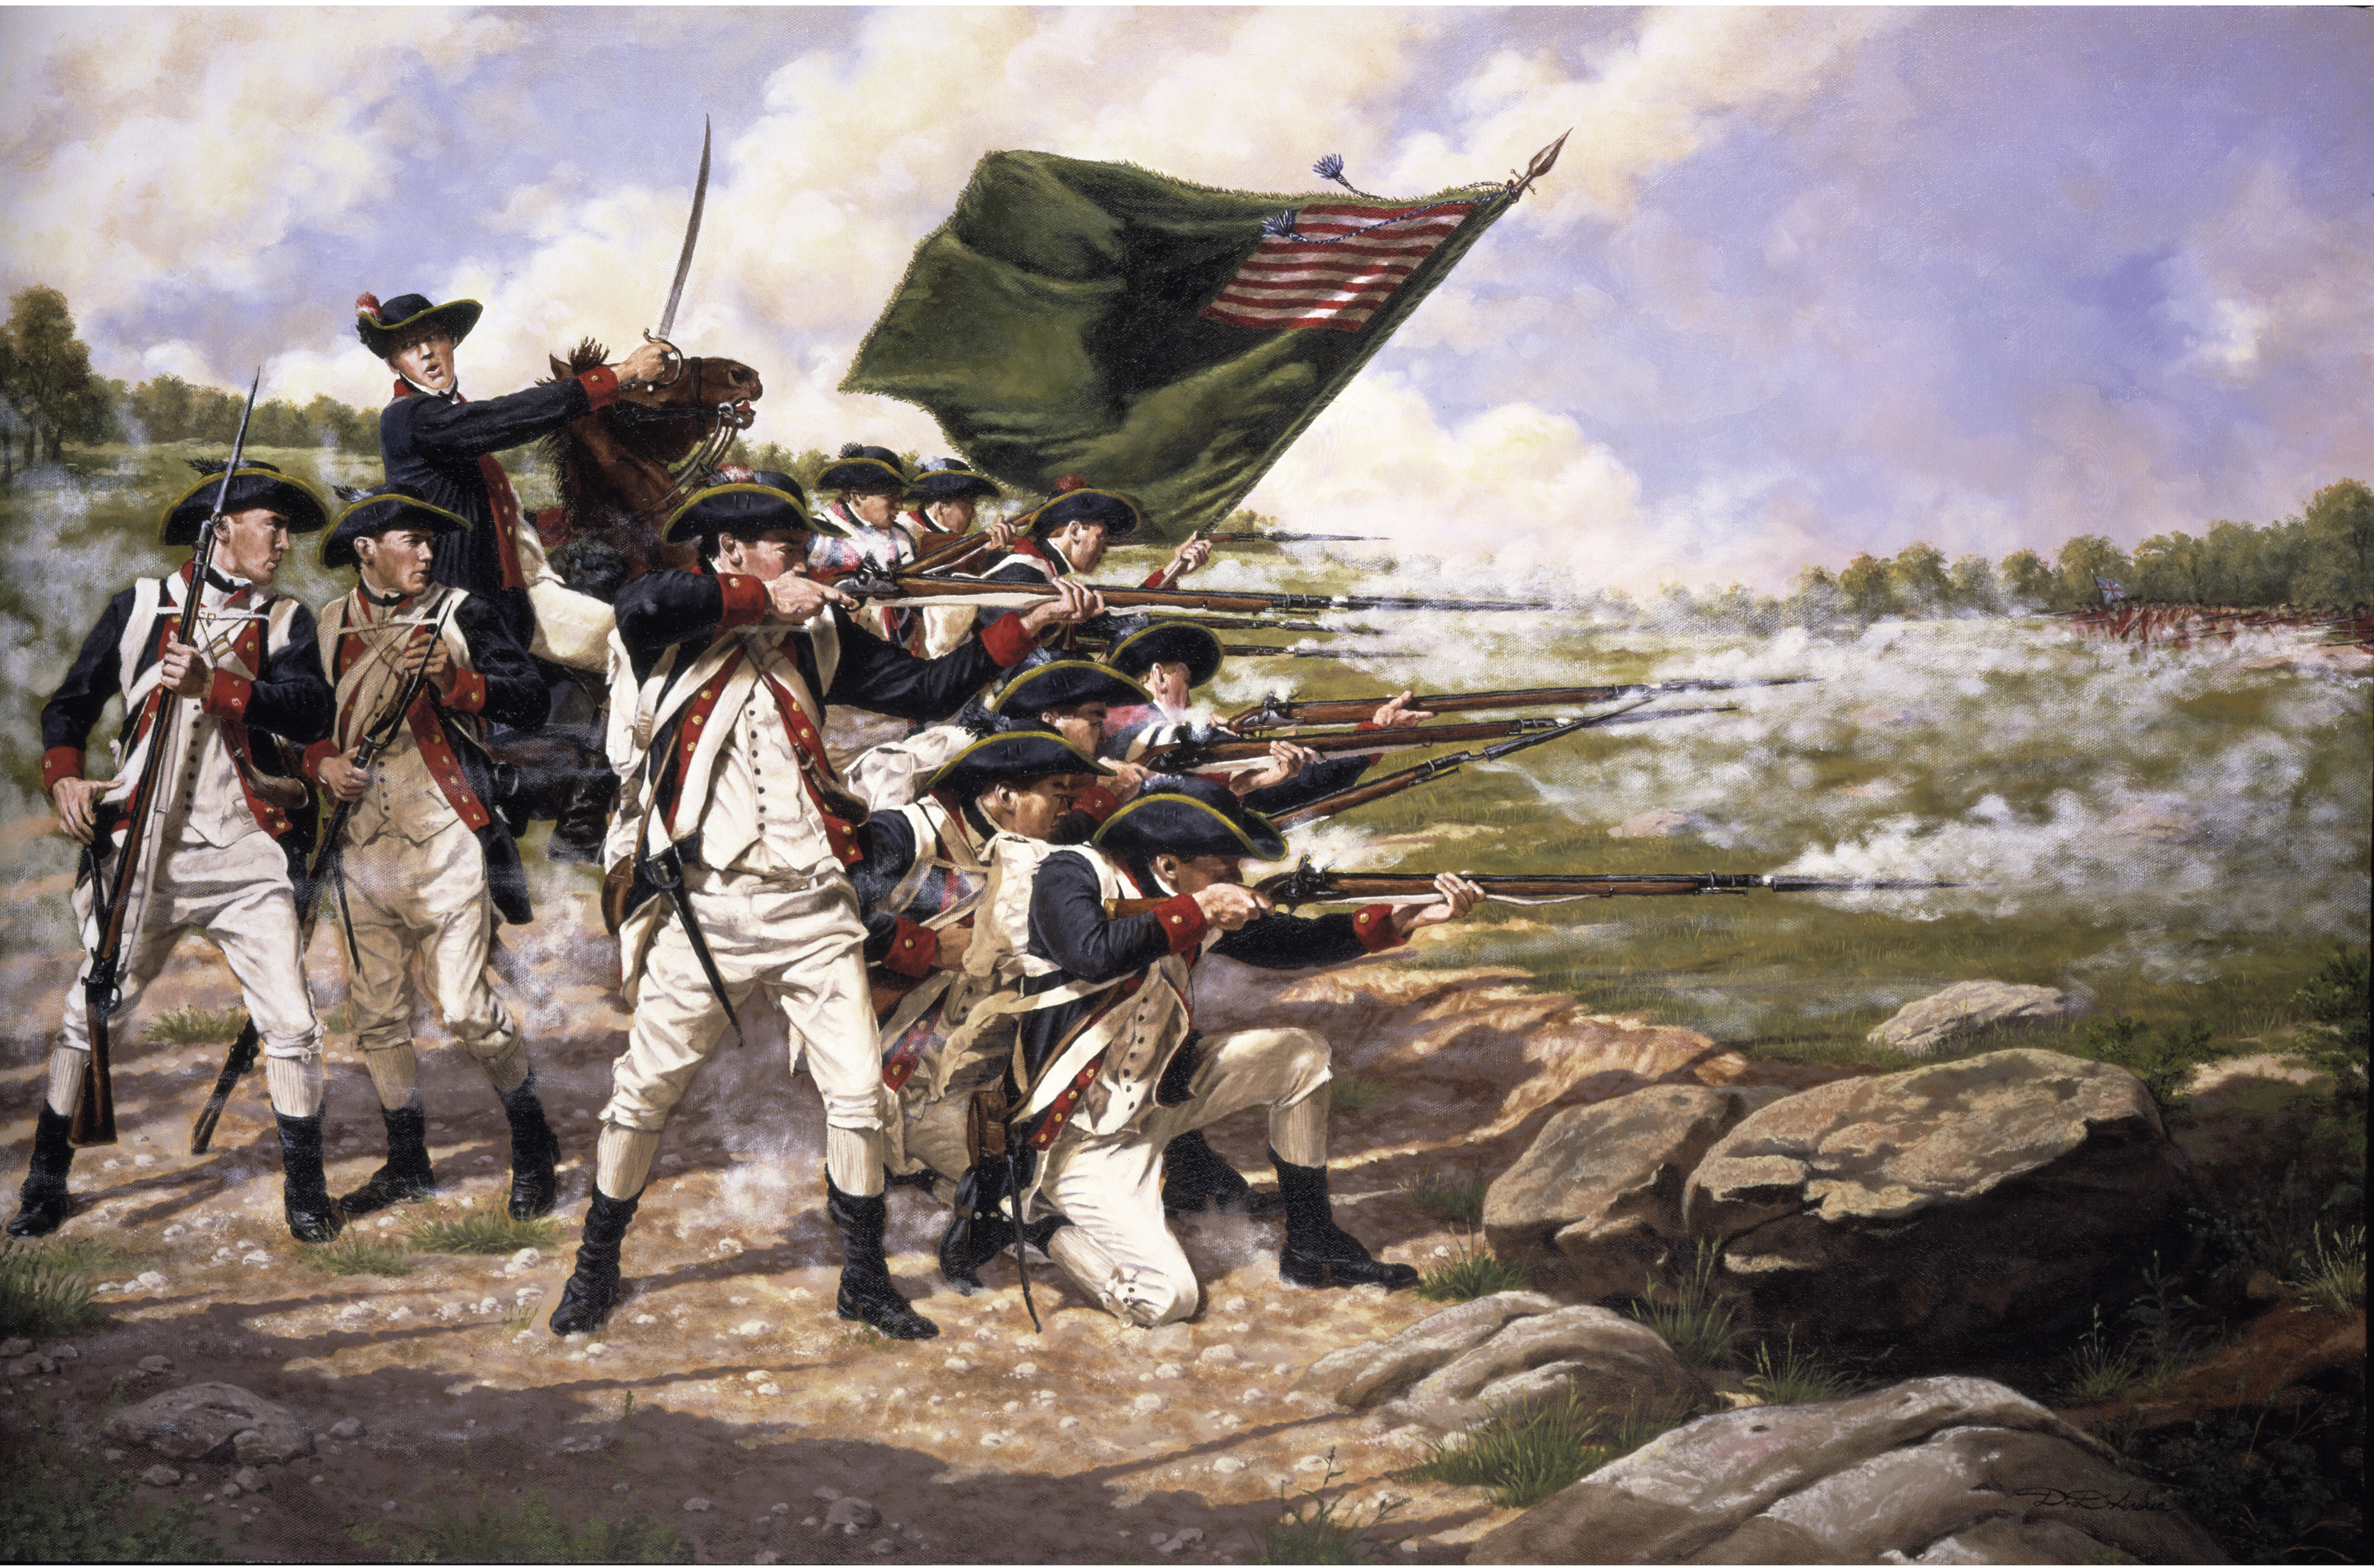
Common Sense
Idea #2- Strong case for economic freedom and the right to military self defense

Slide 10
Common Sense
Idea #3- Cried out against tyranny (the abuse of government power)

Slide 11
Many colonial leaders agreed with Common Sense and then met to write a document declaring the colonies’ independence

Slide 12
Do you think that most colonists would have supported independence from Britain without Thomas Paine’s publication of Common Sense? Why?
Think! Pair! Share!

Slide 13
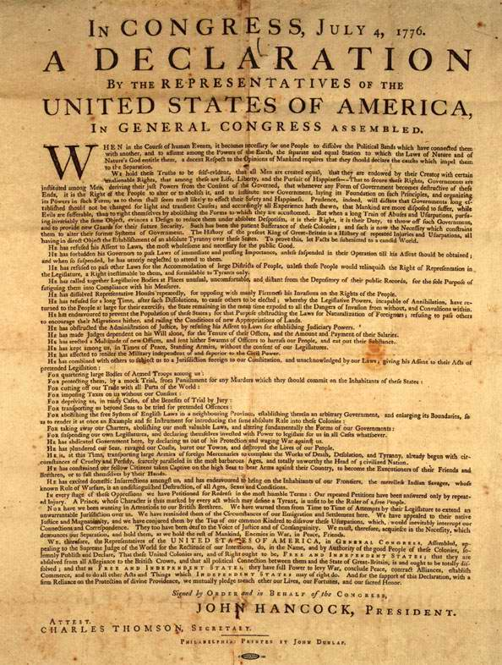
The Declaration of Independence
Definition- Document that formally announced the colonies’ break from Great Britain

Slide 14
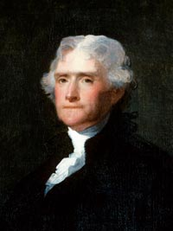
The Declaration of Independence
Author- Thomas Jefferson
Signed- July 4th, 1776

Slide 15
The Declaration of Independence
Argument #1- All men possess unalienable (natural) rights: Life, Liberty, and the Pursuit of Happiness
The Enlightenment idea of natural rights
We are born with certain rights that CANNOT be taken away!

Slide 16
The Declaration of Independence
Argument #2- King George had violated the colonists’ rights by passing unfair laws and interfering with colonial governments
King George taxed the colonists without their consent (opinion)!

Slide 17
The Declaration of Independence
Argument #3- The colonies had the right to break free from Britain and declare independence
The Enlightenment idea of the social contract!
Governments must protect the rights of citizens
Citizens must agree to be governed

Slide 18
Equality?
Even though the Declaration stressed equality among citizens and rulers, the Declaration did not give equality to enslaved Americans or women.
The practices of slavery were inconsistent with the Declaration’s message of equality
So under the Declaration, we’re all equal except slaves?..wait- that doesn’t make sense.

