Slide 1
In Chapter 3, the colonists are going to cut their ties with Britain and fight for their independence!

Slide 2
1st Continental Congress
The closing of the port of Boston (Intolerable Acts) caused the colonies to meet at Carpenter’s Hall in Philadelphia
Each colony (except Georgia) sent delegates to discuss what to do
(Georgia still needed British protection from Native American attacks)
Delegates from NY and Penn. Had orders to seek peace with King George
Others like Patrick Henry, from Virginia, believed that war was unavoidable

Slide 3
Compromises Made during the Congress:
1. Colonies would stop all trade with Britain
2. The colonial militia would prepare for war with Britain
3. The Declaration of Rights would be sent to King George
King George refused to consider it
Instead, he told the British military to seize (or take away) all militia weapons

Slide 4
Videos on the 1st Congress
https://www.youtube.com/watch?v=f6iITHT8LJE
https://www.youtube.com/watch?v=aAVpj_Vo7zk

Slide 5
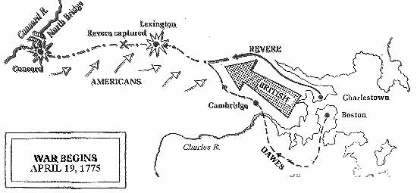
Lexington & Concord
The night of April 18th, 1775
700 British soldiers marched from Boston to Concord
Objective: Find and seize Colonial militia weapons

Slide 6
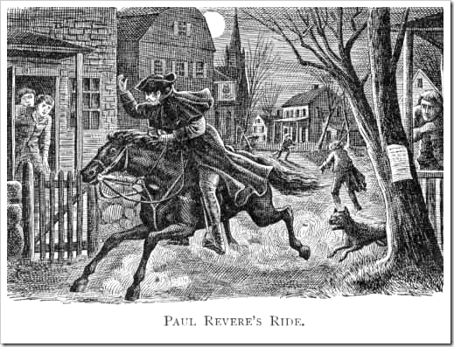
Lexington & Concord
Colonial Spies overheard the British military’s plan to march to Concord and made a signal to alert the colonists in Lexington
This signal was spread by Paul Revere who yelled through the Lexington streets “THE REGULARS (British) ARE COMING!”

Slide 7
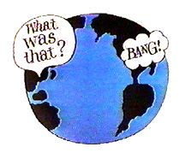
Lexington & Concord
At dawn the British Army arrived in Lexington and met 70 armed minutemen
A shot was fired.. THE SHOT HEARD ROUND THE WORLD
Called so because it’s known as the shot that started the Revolutionary War

Slide 8
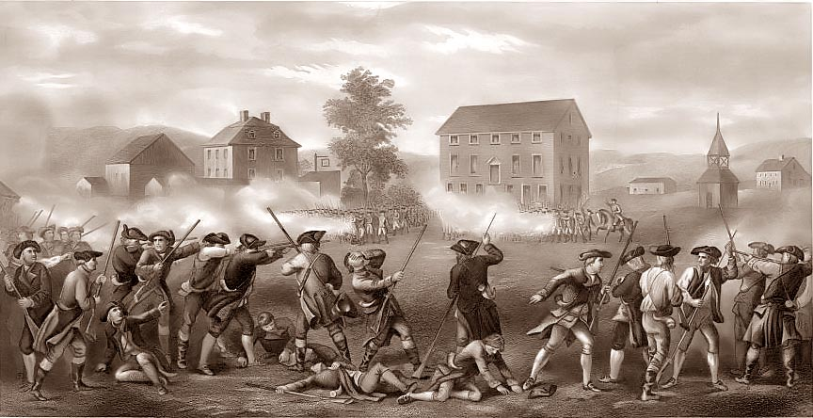
Lexington & Concord
Outcome of the Battle
8 colonial militia men dead
10 colonial militia men wounded
1 British soldier wounded

Slide 9
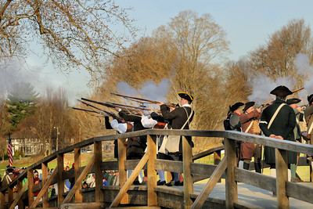
Lexington & Concord
The British continued onto Concord to find and destroy the colonist’s weapons but were stopped by militia minutemen at the Old North Bridge
The British then retreated back to Boston

Slide 10
Guerilla Warfare
On the way back to Boston the British were met by militia using guerilla warfare
Guerilla warfare involved firing from behind trees, fences, and and buildings
By the end of the day
250 British soldiers were dead, wounded, or missing
The minutemen?
Fewer than 100 causalities
https://www.youtube.com/watch?v=GUwfnC0jaDs

Slide 11
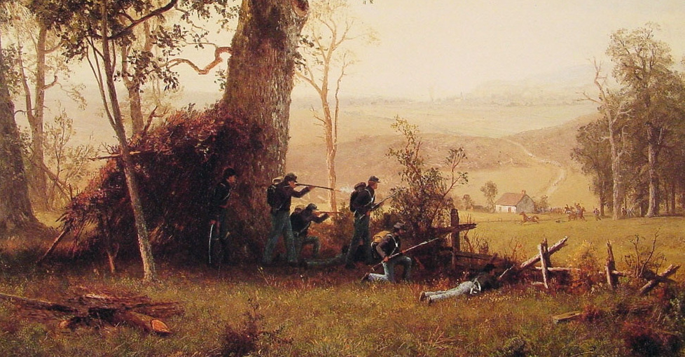

Slide 12
2nd Continental Congress
Delegates from the colonies met again in May 1775 following the battles at Lexington and Concord
Some called for war, others for peace
Again, they compromised..

Slide 13
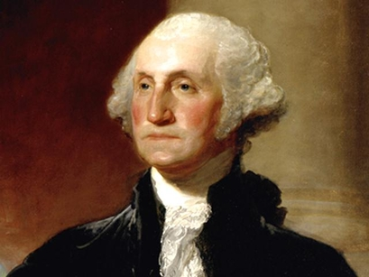
2nd Continental Congress Compromises
1. They did not break away from Britain
2. The Massachusetts militia would become the new Continental Army
3. George Washington would lead the Continental Army

Slide 14
The Olive Branch Petition
Congress signed and sent the Olive Branch Petition to King George asking for peace and more power to the colonies
King George refused to read it ..war was coming soon

Slide 15
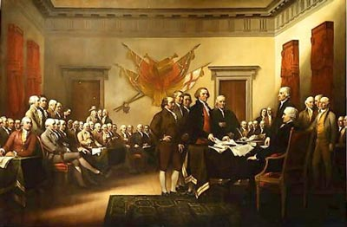
The 1st American Government
The 2nd Continental Congress became America’s first government and ran the country during war

Slide 16
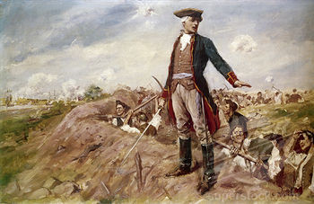
Battle of Bunker Hill
The colonists seemed like no match to the well prepared and armed British army
Colonial commander said to the American troops: “Don’t fire until you see the whites of their (the British soldiers) eyes!”

Slide 17
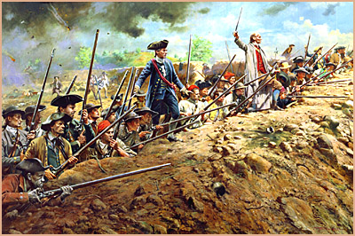
Battle of Bunker Hill
The colonists, after chasing the British back down the hill, soon ran out of ammunition
The colonial soldiers had to throw rocks at the British, use their unloaded guns at clubs, and fight with their bare hands!

Slide 18
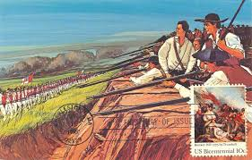
Battle of Bunker Hill
The British suffered double the amount of casualties!

Slide 19
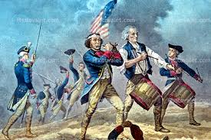
Battle of Bunker Hill
Lasting impact:
Even thought the British took control of the Hill, the Battle of Bunker Hill proved the American colonists could take on the British!

